Slide 1
Advanced Computer Architecture
Prof. Chwan-Chia Wu
Dept of Electrical Engineering
Nat’l Taiwan University of Science & Technology

Slide 2
Course Contents
Parallel Computer Models
Program Properties of Parallelism
System Interconnect Architecture
Instruction Set Architecture – CISC vs RISC
The Microarchitecture - Control Unit Operation
Instruction Level Parallelism and Superscalar Processors
Parallel Processing - Processor Level Parallelism
Multicore Computers
Storage Area Network

Slide 3
References
W. Stalling, Computer Organization and Architecture, 8th ed., Pearson, 2010
A. S. Tanenbaum, Structured Computer Organization, 5th ed., Prentice Hall, 2006.
J. L. Hennessy and D. A. Patterson, Computer Architecture: A Quantitative Approach, 4th ed., Morgan Kaufmann, 2006.
H. El-Rewini and M. Abd-El-Barr, Advanced Computer Architecture and Parallel Processing, Wiley Series on Parallel and Distributed Computing, 2005
D. E. Culler and J. P. Singh, Parallel Computer Architecture, Morgan Kaufmann, 2004.
R. Barker and P. Massiglia, Storage Area Network Essentials, Wiley, 2002.
M. Farley, Building Storage Networks, 2nd ed., Mcgraw Hill, 2001.
T. Clark, Designing Storage Area Networks – A practical Reference for Implementing Fibre Channel SANs, Addison-Wesley, 2000.

Slide 4
Advanced Computer Architecture
Chapter 1
Parallel Computer Models

Slide 5
Why Parallel Architecture
To achieve high computing power to meet performance requirement for computation intensive applications
To provide computing power that a processor will be available 10 or 20 years from now
  Eg. With a 50% annual improvement in processor performance, a parallel machine of a hundred processors can be viewed as providing to applications the computing power that will be widely available 10 years in the future, and a thousand processors reflects nearly a 20-year horizon

Slide 6
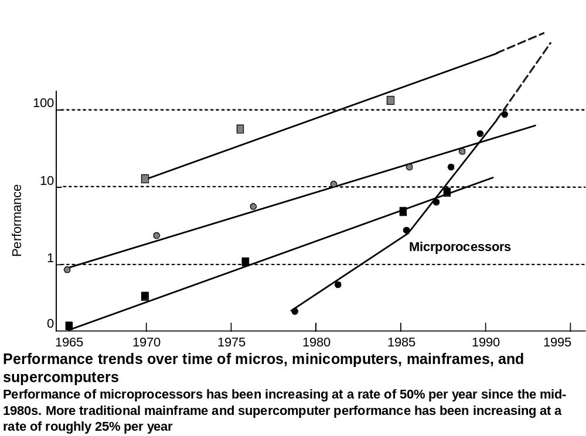
Performance Trend Over Time

Slide 7
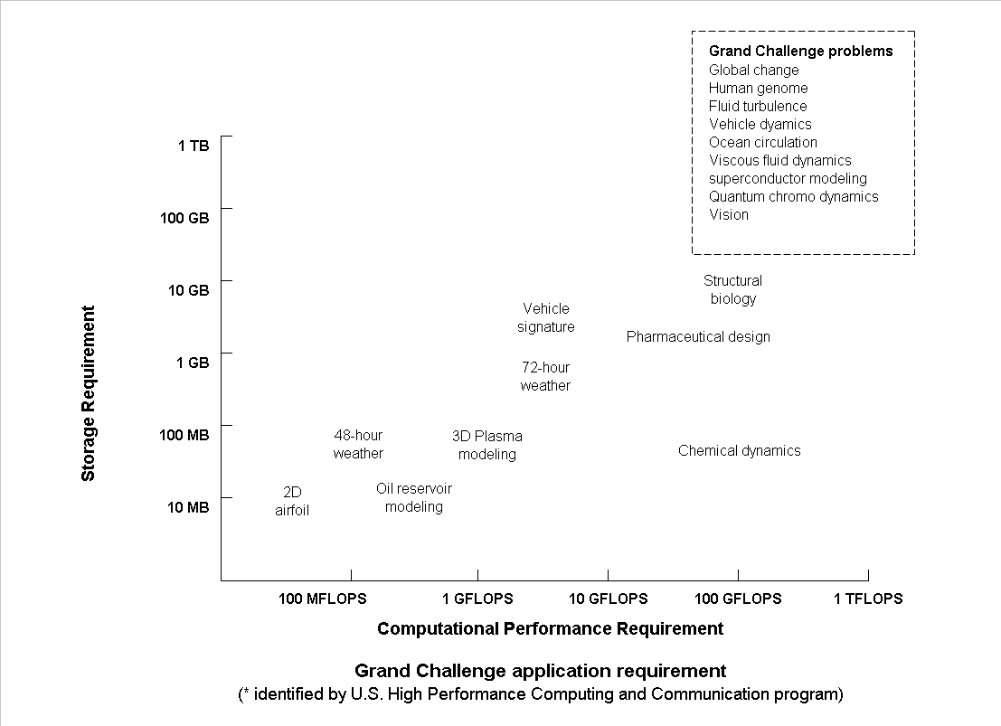
Grand Challenge
Application Requirement

Slide 8
Forms of Parallelism
Instruction Pipelining
Functional Pipelining
Vectorization
Concurrency
Simultaneity
Data Parallelism
Interleaving
Multiplicity
Replication
Multitasking
Multiprogramming
Multithreading
……

Slide 9
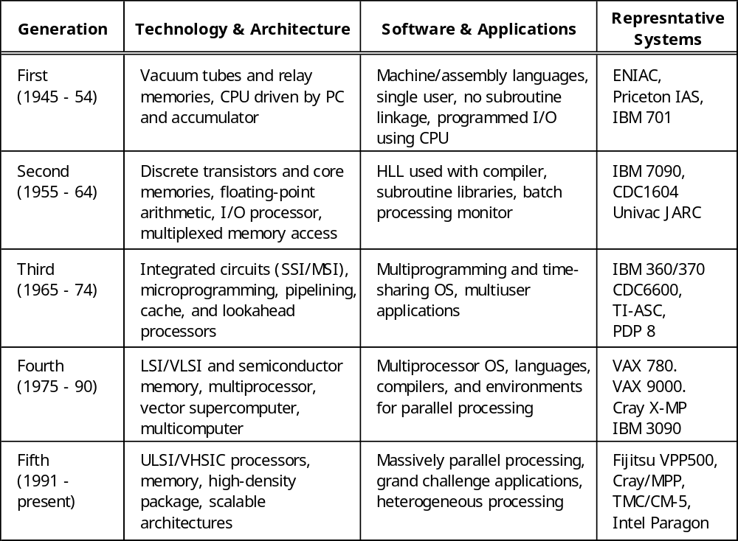
Computer Generations

Slide 10
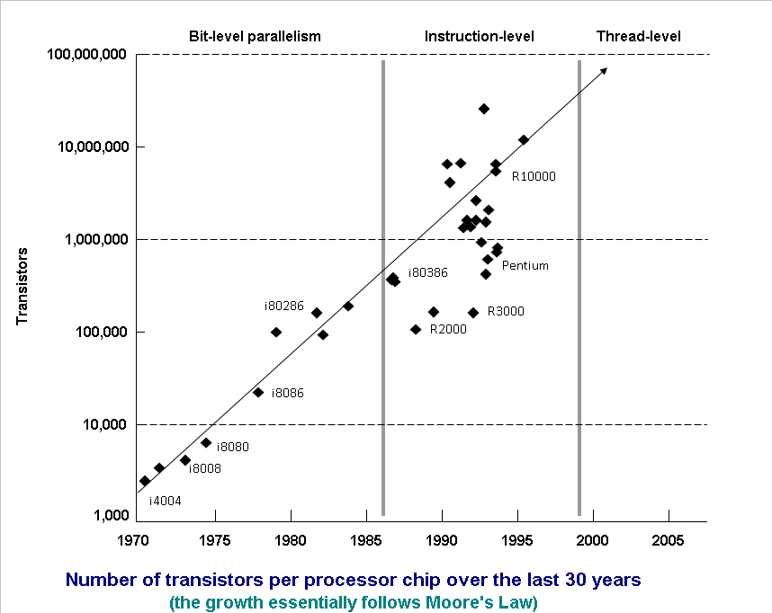

Slide 11
Elements of Modern Computers
A modern computer is an integrated system consisting of machine hardware, an instruction set, system software, application programs, and user interface.
Computer Problems
  For Numerical Problems –complex mathematical formulations and tedious integer or floating-point computations. Science and Technology, Art and Entertainment Applications such as 3D animation, virtual reality, special effects for movies, etc.
  For Alphanumerical Problems – Business & Government accurate transaction, large database management, and Information retrieval operations
  For AI Problems – Logic inference & symbolic manipulation, numerical computing, logical reasoning

Slide 12
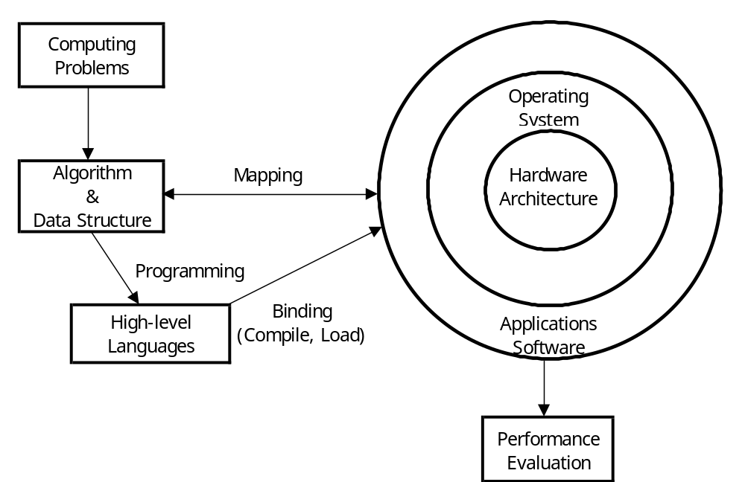
Elements of Modern Computers

Slide 13
Algorithm and Data Structure
Needed to specify the computations and communications involved in computing problems
  In the area of Parallel Algorithms
    Dealing with the design and mapping of algorithms or heuristics onto parallel computers
The mapping of algorithms and data structures onto the machine architecture includes processor scheduling, memory maps, inter-processor communications, etc. These activities are usually architecture-dependent.
This course is more concerned about the resources mapping problem than about the design of parallel algorithms

Slide 14
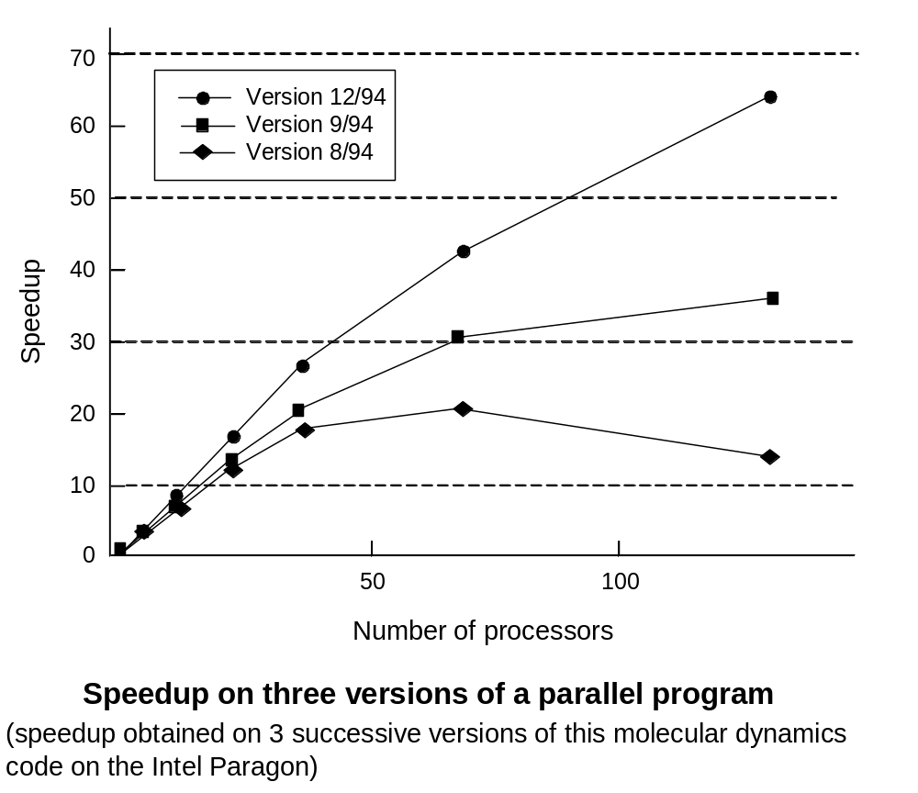

Slide 15
Hardware Resources
Topics to be presented:
  Instruction-set processors
  Memory organization
  Multiprocessors
  Supercomputers
  Multicomputers
  And massively parallel computers

Slide 16
Operating Systems
An effective OS manages the allocation and de-allocation of resources during the execution of user programs
Beyond OS, application software must be developed to benefit the users. Standard benchmark programs are needed for performance evaluation.

Slide 17
System Software Support
Source code written in HLL → (Compiler) object code → (Assembler) machine code → (Loader) to initiate the program execution thru the OS kernel
Today, programming parallelism is still very difficult for most programmers due to the fact that existing languages were originally developed for sequential computers.
Ideally, we need to develop a parallel programming environment with architecture-independent languages, compilers and software tool.
Goal for development of a parallel language –
  Efficiency in implementation, portability across different machines, compatibility with existing sequential languages, expressiveness of parallelism, and ease of programming.

Slide 18
Evolution of Computer Architecture
From an assembly language programmer point of view:
  Computer architecture is abstracted by its instruction set, which includes OP code, addressing modes, registers, virtual memory, etc.
From the hardware implementation point of view:
  CPU, caches, system interconnection, microcode, pipelines, physical memory, etc.

Slide 19
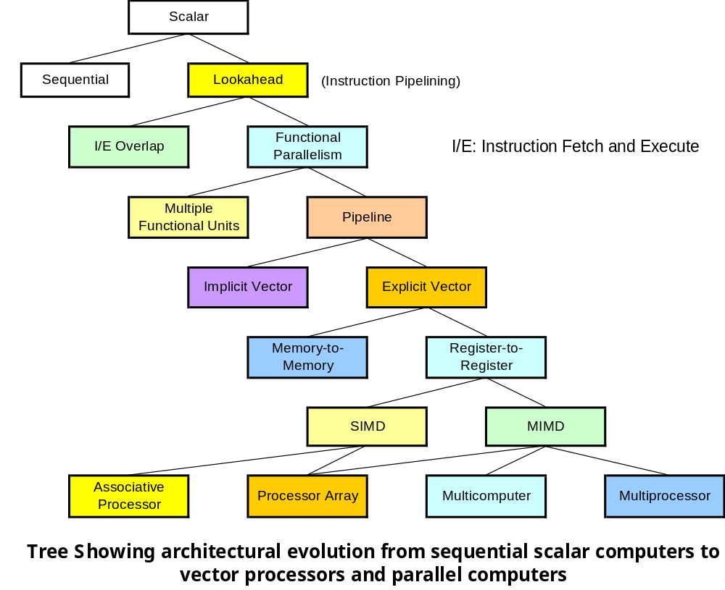

Slide 20
Flynn’s Classification (1972)
SISD
  Single Instruction Stream / Single Data Stream
SIMD
  Single Instruction Stream / Multiple Data Stream
MISD
  Multiple Instruction Stream / Single Data Stream
MIMD
  Multiple Instruction Stream / Multiple Data Stream

Slide 21
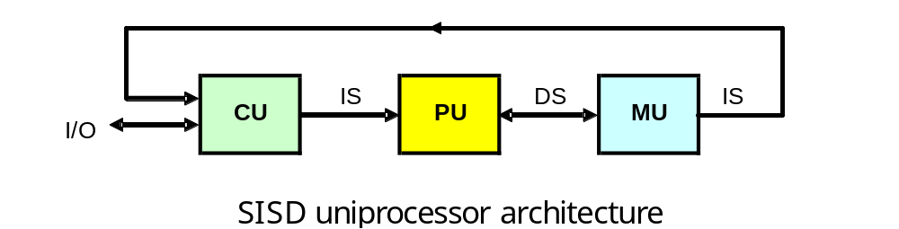
Flynn’s Classification
SISD

Slide 22
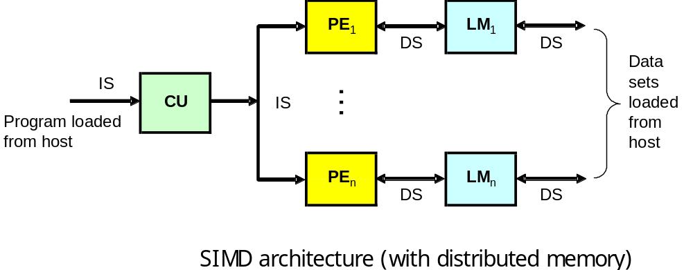
Flynn’s Classification
SIMD
For example: Processor Array

Slide 23
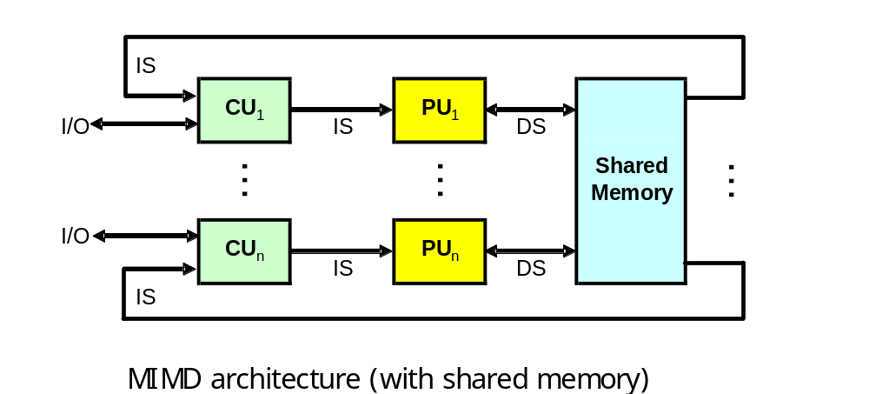
Flynn’s Classification
MIMD
For example: Multiprocessor, Multicomputer

Slide 24
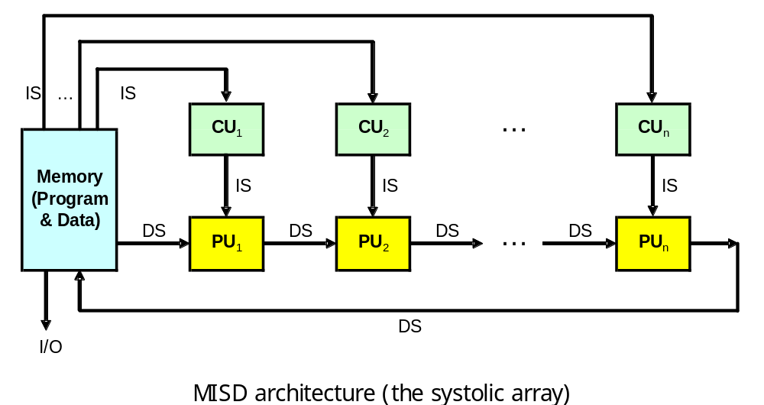
Flynn’s Classification
MISD – never commercially available

Slide 25
Flynn’s Classification
Parallel Architecture
  SIMD, MISD, MIMD
Popularity
  (1) MIMD (2) SIMD (3) MISD

Slide 26
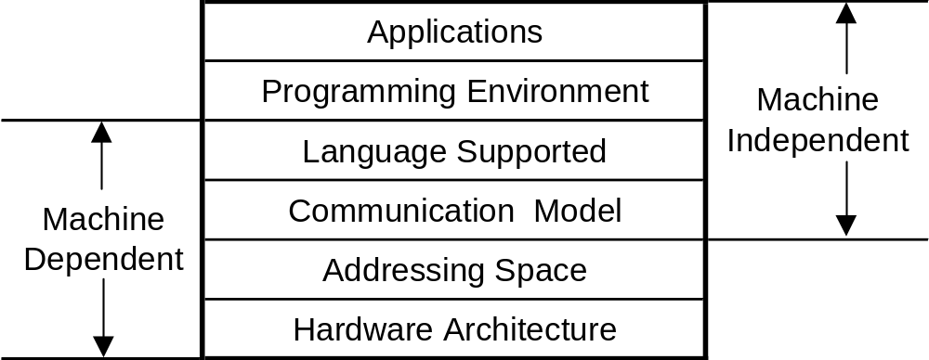
Parallel / Vector Computers
Two major classes of parallel computers:
  Shared-memory Multiprocessors
    The processors communicate with each other through shared variables in a common memory
  Message-passing Multicomputers
    Each computer node has a local memory, unshared with other nodes
Development Layers
  Ni’s Classification (1990)

Slide 27
Shared-Memory Multiprocessors
Three models of MP
  UMA: Uniform-Memory Access
  NUMA: Nonuniform-Memory Access
  COMA: Cache-Only Memory Access

Slide 28
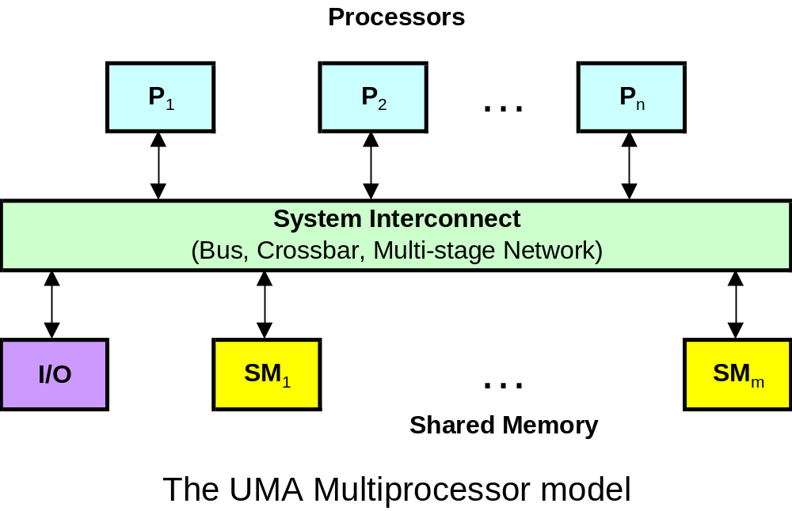
Shared-Memory Multiprocessors
The UMA Model (Tightly-coupled MP)

Slide 29
Shared-Memory Multiprocessors
The UMA Model (Tightly-coupled MP)
  The UMA model is suitable for general-purpose and time-sharing applications by multiple users. It can be used to speed up the execution of a single large program in time-critical applications
  To coordinate parallel events, synchronization and communication among processors are done through using shared variables in the common memory

Slide 30
Shared-Memory Multiprocessors
The UMA Model (Tightly-coupled MP)
  Symmetric Multiprocessor (SMP):
    All processors have equal access to all peripheral devices, and are equally capable of running the executive program such as OS kernel and I/O service routines.
  Asymmetric Multiprocessor:
    Only one or a subset of processors are executive-capable. The executive or master processor can execute OS and handle I/O. The remaining processors have no I/O capability and thus are called attached processors (APs). Attached processors execute user codes under the supervision of the master processor.

Slide 31
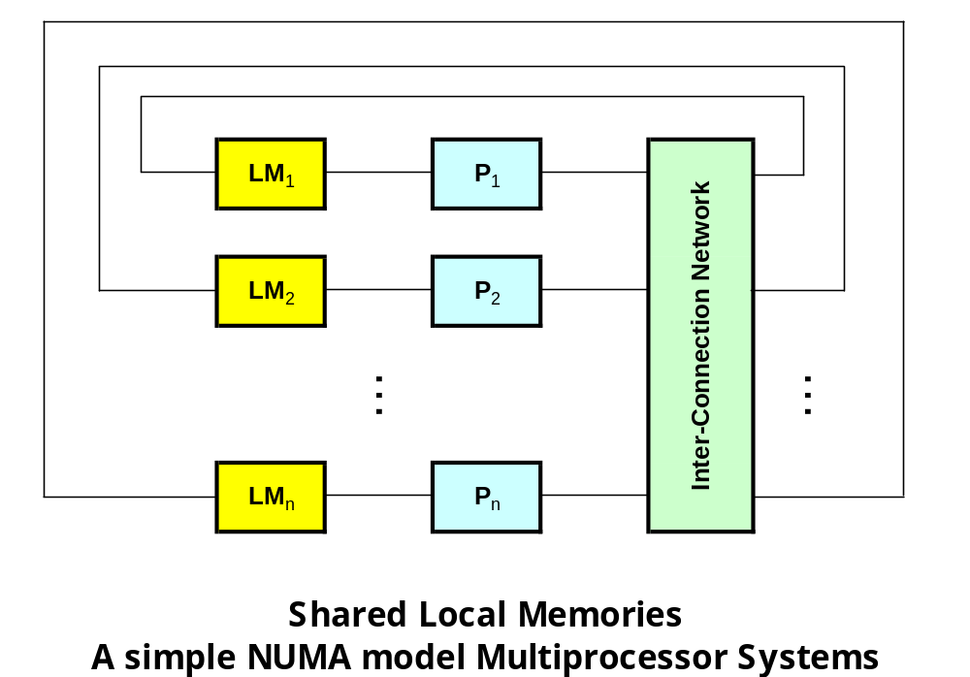
Shared-Memory Multiprocessors
The NUMA Model – a shared-memory system in which the access time varies with the location of the memory word

Slide 32
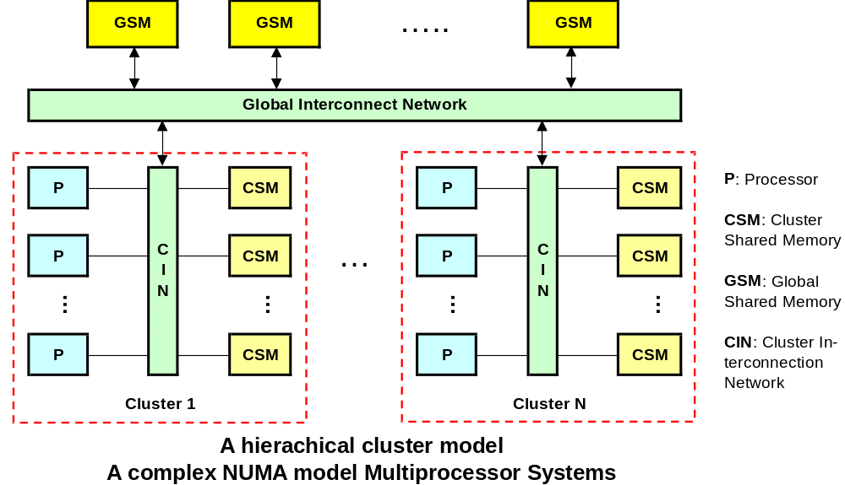
Shared-Memory Multiprocessors

Slide 33
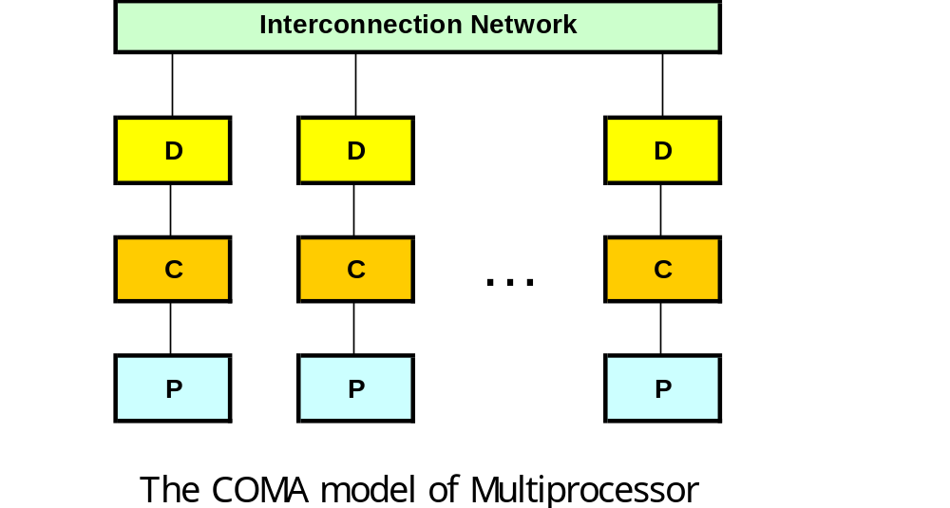
Shared-Memory Multiprocessors
The COMA Model - MP using cache-only memory
  COMA is a special case of NUMA machine, in which the distributed main memories are converted to caches

Slide 34
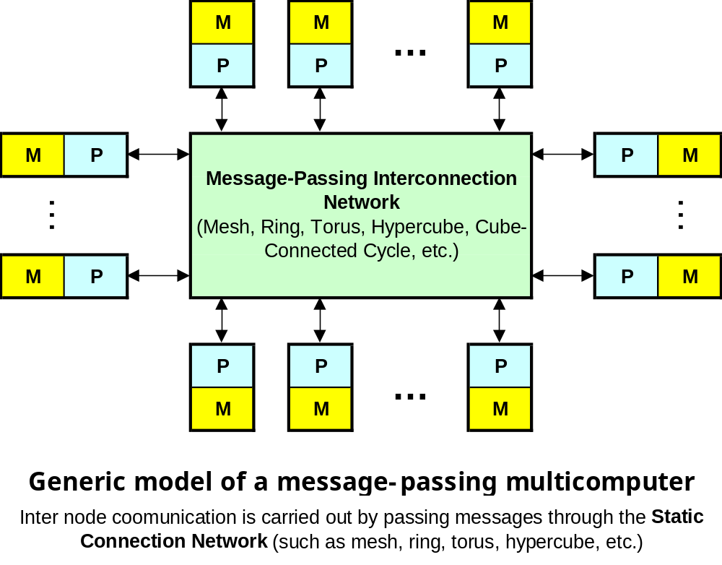
Distributed-Memory Multicomputers

Slide 35
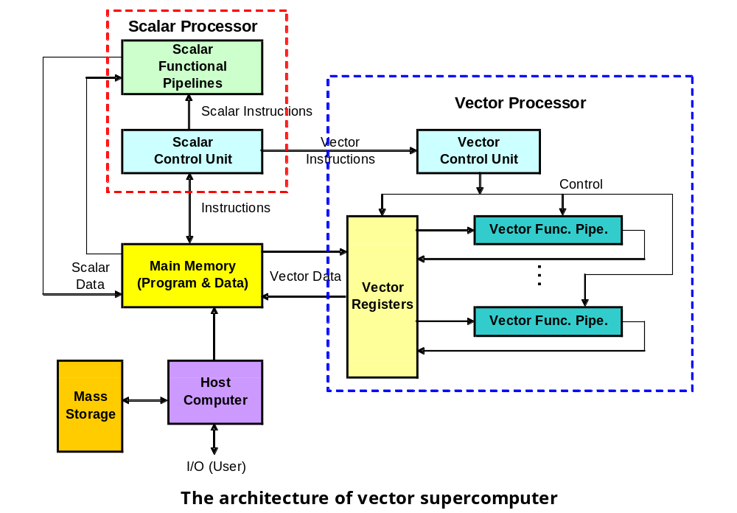
Multivector and SIMD Computers
Vector Supercomputers

Slide 36
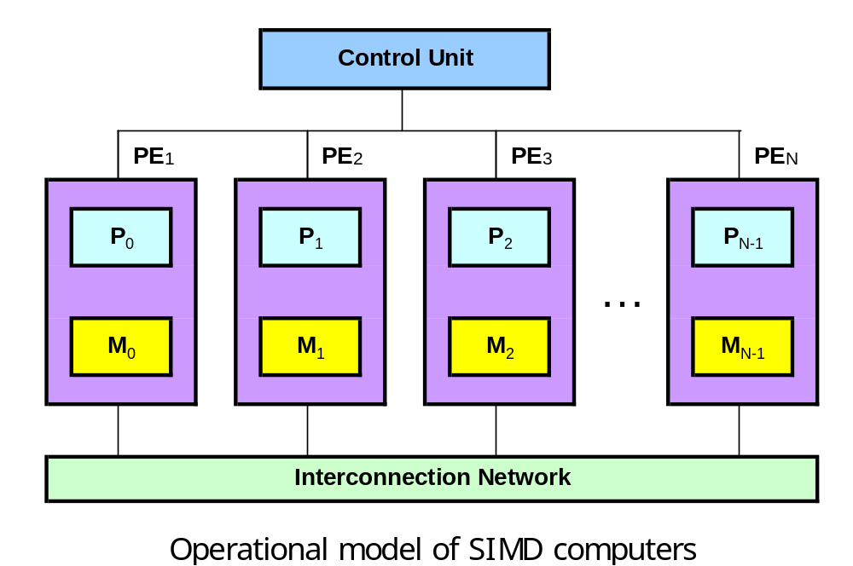
Multivector and SIMD Computers
SIMD Supercomputers

Slide 37
Q & A

